Slide 1
Science
(Chapter 12)
Bobir Muratov

Slide 2
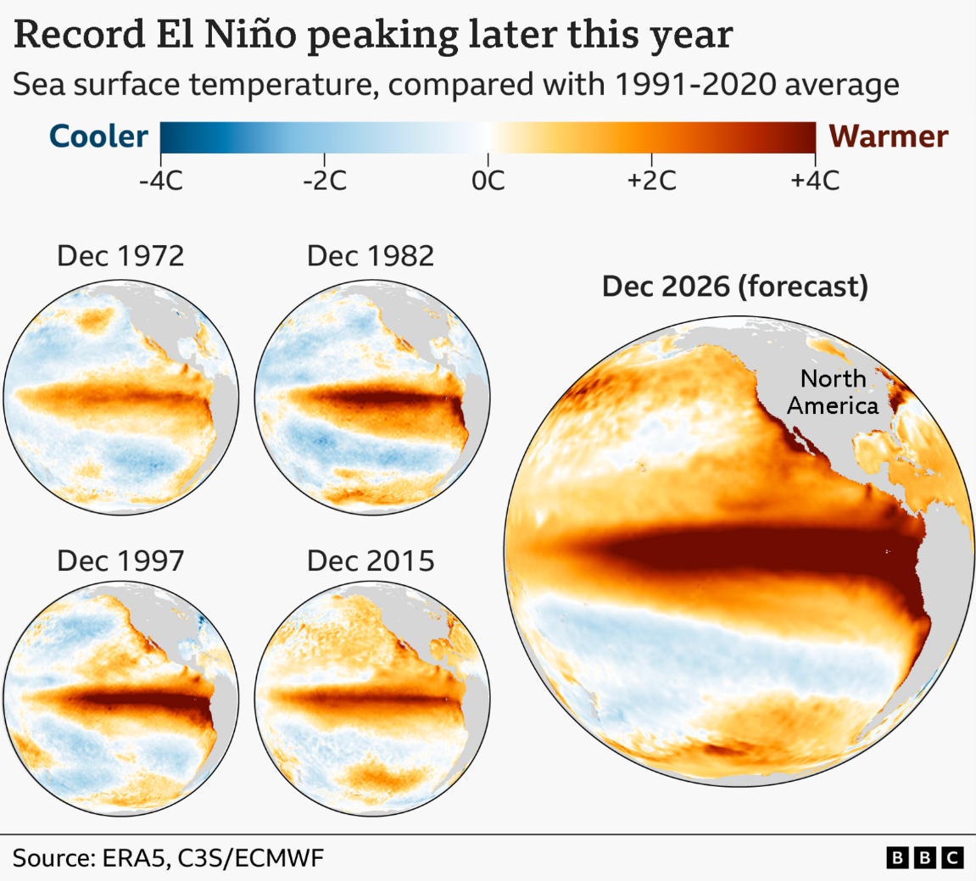
Introduction
Global warming
Covid
Nuclear energy
AI
Vaccines

Slide 3
What’s to Come
What is Science
The Scientific Method
Evaluating Scientific Hypotheses
Research Methodology
Ethical Concerns in Science
Thomas Kuhn and Scientific Paradigms

Slide 4
What is Science
Science – the use of reason to move from observable, measurable facts to hypotheses to testable explanations for those facts
Assumptions underlying science:
Empiricism – our physical senses are the primary source of knowledge
Objectivity – we can observe and study the physical world without observer bias
Materialism – everything in the universe is composed of physical matter
Predictability – the universe is made up of interconnected causal relationships
Unity – the universe has an underlying unified dynamic structure

Slide 5
What is Science
Limitations of science
Rene Descartes – we only have an idea in our mind of a world outside of us, not direct evidence that world out there actually exists
Empiricism limits science to observable
Observation alone cannot logically establish a necessary causal connected between the two events
Experience of reality is dependent on our brains
Quantum mechanics

Slide 6
What is Science
Science and religion
Positions regarding the relationship between science and religion:
Science always trumps religion when there is a conflict
Religion always trumps science when there is a conflict
Science and religion operate in two separate and mutually exclusive realities
Science and religion are concerned with the same reality and are compatible and complementary
https://www.youtube.com/watch?v=rmRH80lj9UM

Slide 7
The Scientific Method
Scientific method – a process involving the rigorous, systematic application of observation and experimentation
Steps:
Identify the problem
Develop an initial hypothesis (explanation) (scientific theory)
Gather additional information and refine the hypothesis
Test the hypothesis
Evaluate the hypothesis on the basis of results of testing or experimentation

Slide 8
Evaluating Scientific Hypotheses
Criteria for evaluating hypotheses:
Is it relevant to the problem under investigation?
Is it consistent with well-established theories?
Is it the simplest explanation for the problem?
Does it provide a testable and falsifiable explanation of the problem?
Can it be used to predict the outcome of similar events?
Pseudoscience – a body of explanations or hypotheses that masquerades as science, is based on emotional appeals, superstition, rhetoric
Ex., astrology, psychic healing, numerology, mind reading, etc

Slide 9
Research Methodology
Research methodology – a systematic approach in science to gathering and analyzing information
Research methods/designs:
Experimental Research (intervention, simulation, lab)
Correlational Research
Survey Research
Ethnographic Research
Grounded Theory Research
Narrative Research
Action Research
Mixed Method Research

Slide 10
Ethical Concerns in Science
Issues in data collection (informed consent, respect the site/participants/norms)
Issues in data reporting (honest reporting, proper citation, publishing on time)
“Publish or perish” pressure
Concerns on neutrality of science

Slide 11
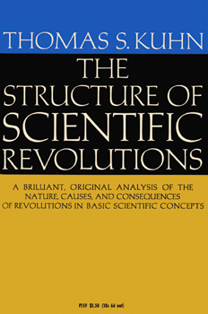
Thomas Kuhn and Scientific Paradigms
Kuhn challenged the idea that the scientific method is objective and that science is progressive
Normal science – scientific research that is based on past achievements and is recognized by most scientists
Paradigm – the accepted view of what the world is like and how should go about studying it
Scientific revolution – a paradigm shift in which a new scientific theory replaces a problematic paradigm

